Slide 1


Driving Safety Advisor: Your Road Safety Companion
Discover how Driving Safety Advisor empowers safe driving. Our platform blends technology with practical tips.

Slide 2
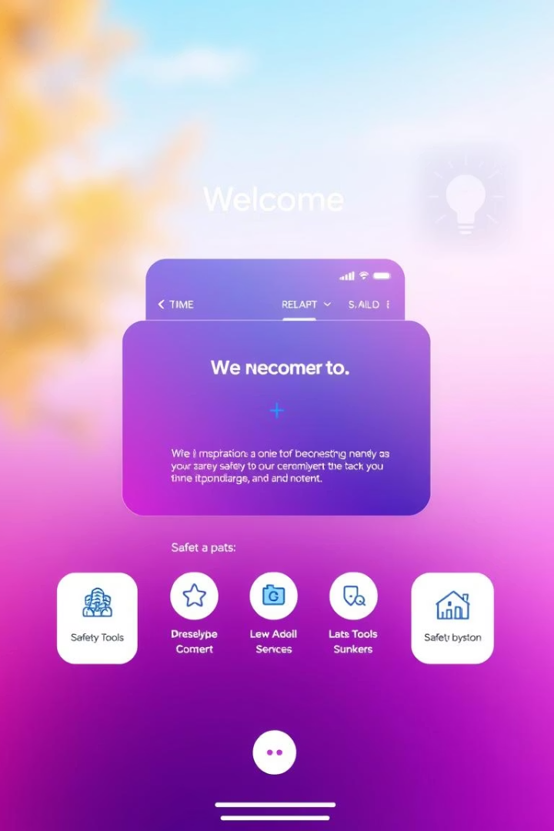
Welcome to Driving Safety Advisor Home Page
Intuitive Interface
Easy navigation for all users.
Instant Access
.
Quick links to all safety modules.

Slide 3
Dashboard Overview
Safety Calculator
Safety Analysis
Safety Statistics
Calculate your driving risk with real-time inputs.
Review detailed safety performance insights.
Visualize trends through interactive charts.

Slide 4
Safety Tips: Guarding Your Drive
Seatbelt Safety
Distracted Driving
Always buckle up for maximum protection.
Avoid phone use and stay focused.
Speed Limits
Weather Conditions
Adhere to limits for legal and safe driving.
Drive cautiously during rain, snow, or fog.
Vehicle Maintenance
Emergency Preparedness
Regular checks prevent unexpected breakdowns.
Keep an emergency kit ready at all times.

Slide 5

Safety Resources: Video Tutorials
Comprehensie Guides
Expert Advice
Learn from certified safety professionals.
Step-by-step driving safety tutorials.
Accessible Anytime
Watch videos on any device, anywhere.

Slide 6
Route Planning and Emergency Contacts
Route Planning
Emergency Contacts
Use Google Maps to plan safe and efficient routes.
Access quick-dial contacts for roadside help.

Slide 7

AI-enabled Chatbot Assistance
Instant Help
Personalized Support
Get answers to common safety questions 24/7.
Tailored guidance based on your driving behavior.
Continuous Improvement
Machine learning enhances chatbot accuracy over time.

Slide 8
Future Enhancements & Technology
Upcoming Features
Technologies Used
Advanced AI analytics for real-time hazard alerts
HTML, CSS, JavaScript for responsive design
Voice control integration for hands-free use
Receive tailored safety notifications.
Gemini AI API for chatbot and analysis
Google Maps API for route planning

Slide 9




Conclusion and Next Steps
Explore Features
Start with the dashboard and safety tips.
Use Resources
Watch tutorials and plan your routes.
Stay Safe
Leverage AI chatbot and updates regularly.

Slide 10
GitHub Link : https://github.com/prajot2610/Driving-Safety-Advisor-With-Ai-Chatbot

